Slide 1
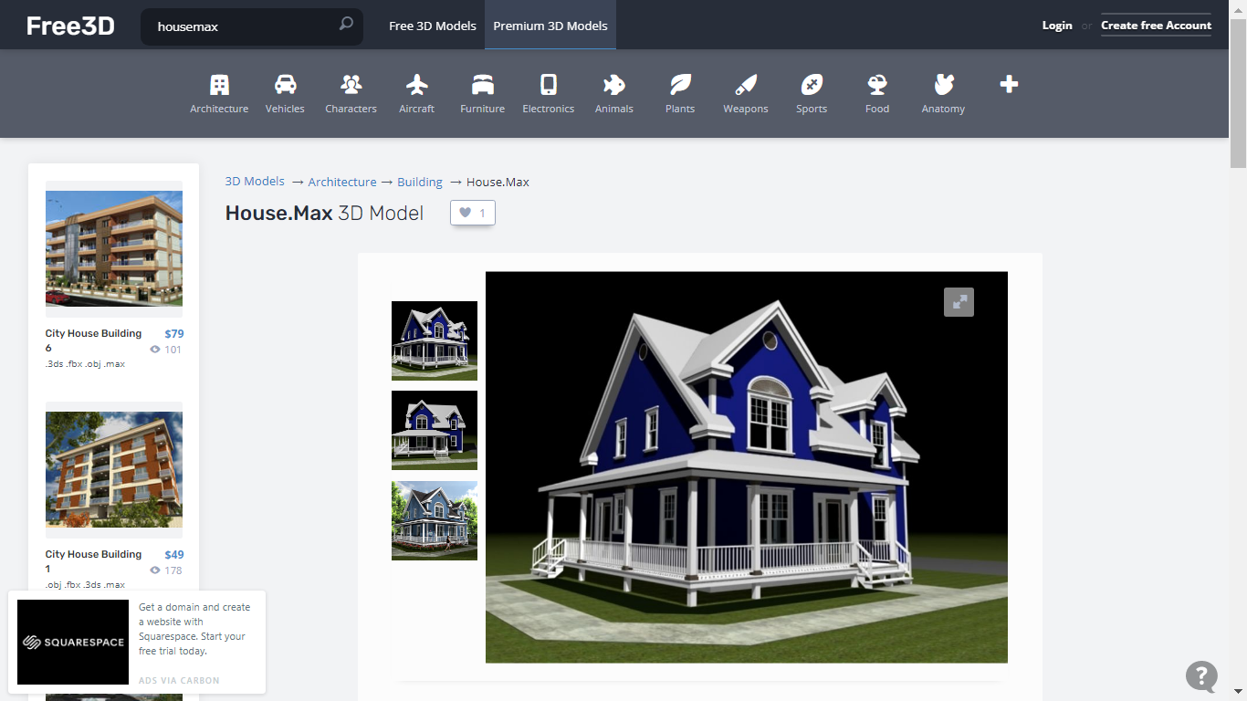
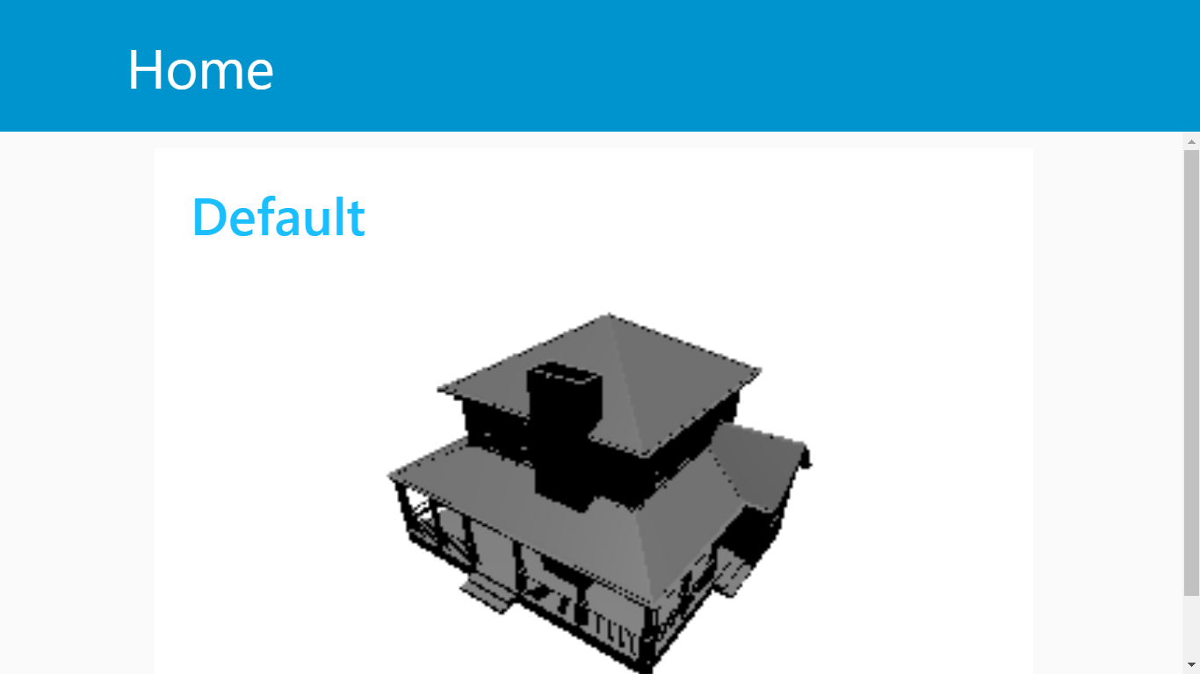
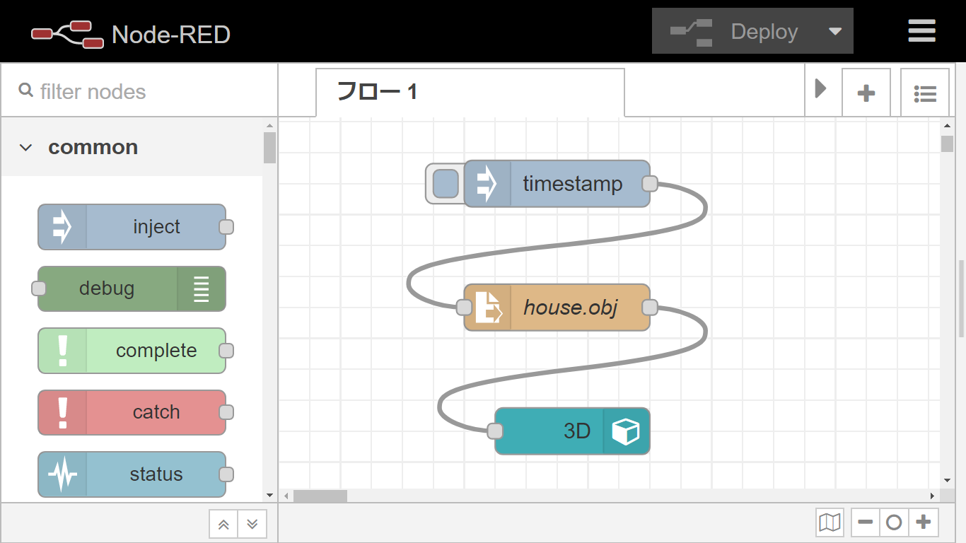
3D UI node (ui_3d) for Node-RED Dashboard
We started to create 3D UI node to visualize 3D object data.
In our plan, we will use the Node-RED dashboard for digital twin use cases.
https://free3d.com/3d-model/house-max-5151.html
# | Question
1 | Can we submit the 3D node to the node-red-ui-node repository after we developed it?

Slide 2
